Slide 1
Comfort to the core.

Slide 2
Who we are
A multi-generational family business dedicated to Comfort, Innovation,
Service and Quality.
We are a family-owned business based in Ohio where our families founded the company in 1983. Although we started back in Europe in 1860 when our family created a down and feather collection system for fellow farmers.
Building a reputation as a company that only provides quality products, it’s what drove us since the very beginning to set the standards of comfort, by focusing on using the finest materials and highest quality craftsmanship. That dedication and hard work paid off, allowing us today to become the true leaders in comfort solutions.
Our clients are some of the top names in apparel, retail, and hospitality, including North Face, Patagonia, Canada Goose, Macy’s, Bloomingdales, Boll and Branch, Costco, Starwood Hotels, and many more.
2

Slide 3
What we do
HOME
From everything-bedding for Home & Hospitality to the best responsibly sourced Down & Feather for the Outdoor Apparel market.
HOSPITALITY
If you are in the business of Hospitality, Retail and E-comm bedding or Outdoor Apparel, we got you covered.
Our five U.S.-based design, development, manufacturing sites, and global sourcing team are prepared to meet all your demands.
There’s a reason why some of the top names in every industry, chose us: we create the experience your customers will keep coming back to you for.
Conducting all affairs with integrity is the basis for trust and mutually beneficial relations with our employees, customers, suppliers, partners, and communities.
OUTDOOR
4

Slide 4
Where we are
North American Manufacturing & Distribution Facilities:
Mason, OH, USA: Corporate HQ
Blue Ash, OH, USA: Feather & Down Processing
Blue Ash, OH, USA: Distribution Center
Toronto, ON, CA: Feather & Down Processing
North Carolina, USA Mattress Pads
International Offices:
China: Sourcing & Quality Assurance Offices
Europe: Sourcing Office
3

Slide 5
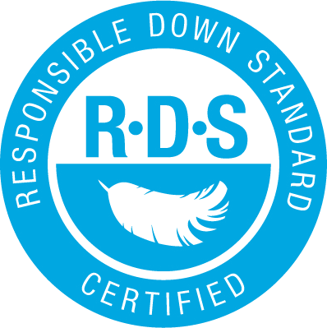
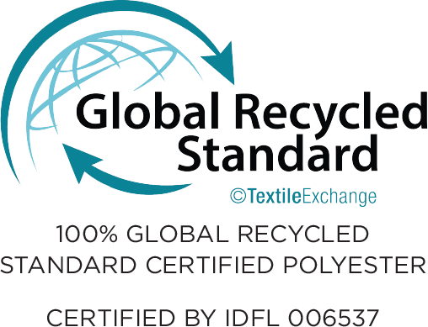
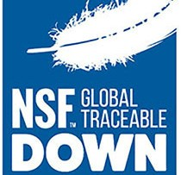
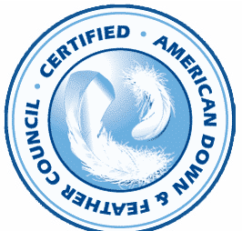
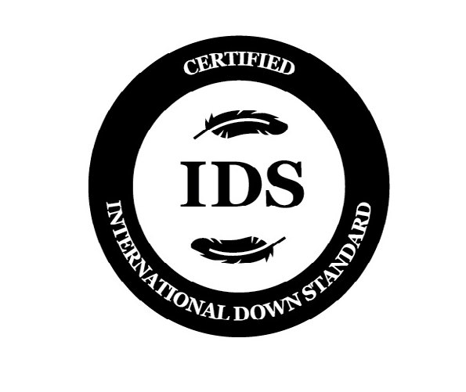
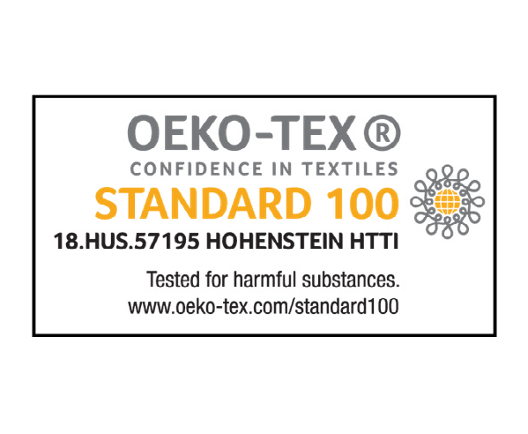
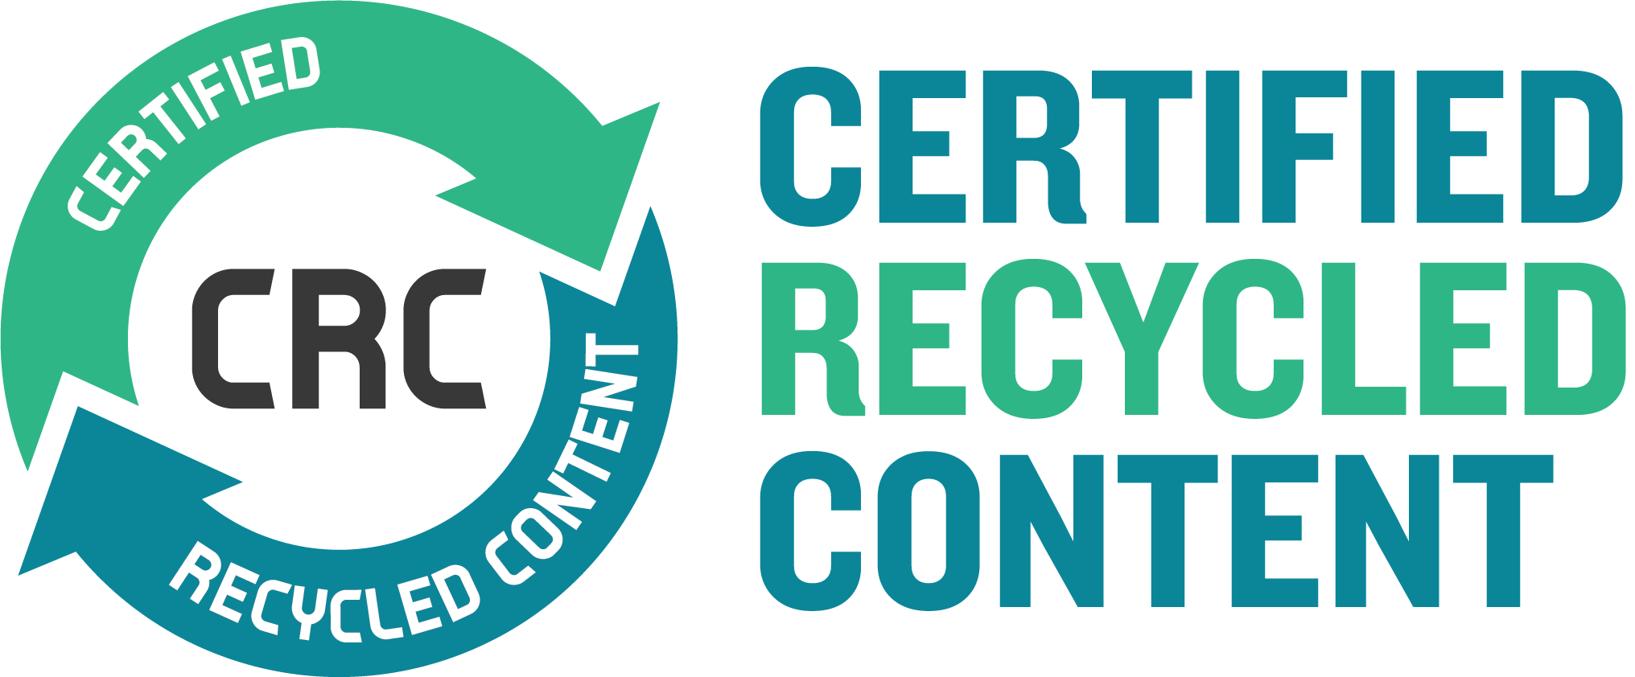
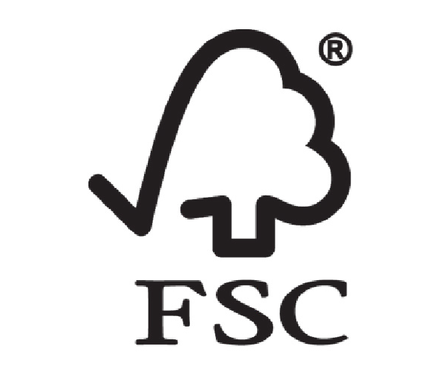
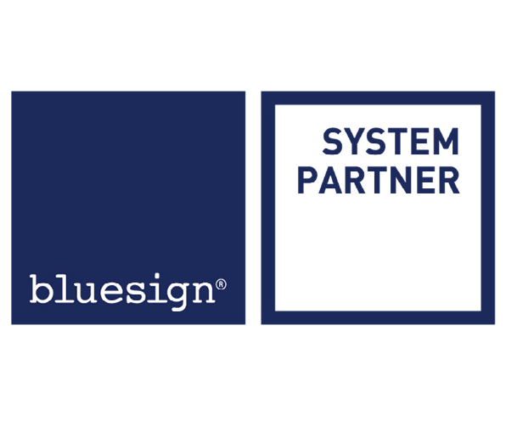
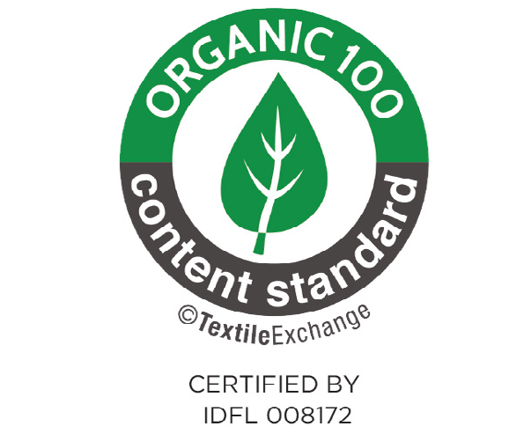
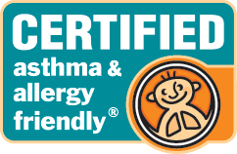
Our Certifications
We are RDS certified and we bring in more material each month that carries this 3rd party certification. Created by The North Face to help ensure traceability and responsibility for feather & down material.
The SAC is a global multi-stakeholder nonprofit alliance for the consumer goods industry aiming to to develop
sustainable solutions that redefine the industry.
The GRS is an international, voluntary, full product standard that sets requirements for third-party certification of recycled content, chain of custody, social and environmental practices and chemical restrictions.
We are TDS/NSF certified and can provide various qualities of down & feather that carry the certification. Created by Patagonia to help ensure traceability and responsibility for feather & down material.
The ADFC Seal of Approval ensures that a product is manufactured by an ADFC member in good standing. ADFC members adhere to standards of quality that meet or exceed all claims made on the label or packaging.
Our IDS certification allows us to demonstrate our ability to provide ethically produced materials and helps retailers and brands confirm their materials are produced ethically.
OEKO-TEX® STANDARD
100 is one of the world’s best-known labels for textiles tested for harmful substances. It stands for customer confidence and high product safety.
FSC certification ensures that our products come from responsibly managed forests that provide environmental, social and economic benefits.
Our soaps and chemistries used to process our down & feather are certified by Blue Sign. All chemistries are fluorine-free.
The Asthma and Allergy Foundation of America (AAFA), is the leading patient not-for-profit organization for people with asthma and allergies, and the oldest asthma and allergy patient group in the world.
The Organic Content Standard (OCS) is a voluntary global standard that sets
the criteria for third-party certification of organic materials and chain of custody.

Slide 6
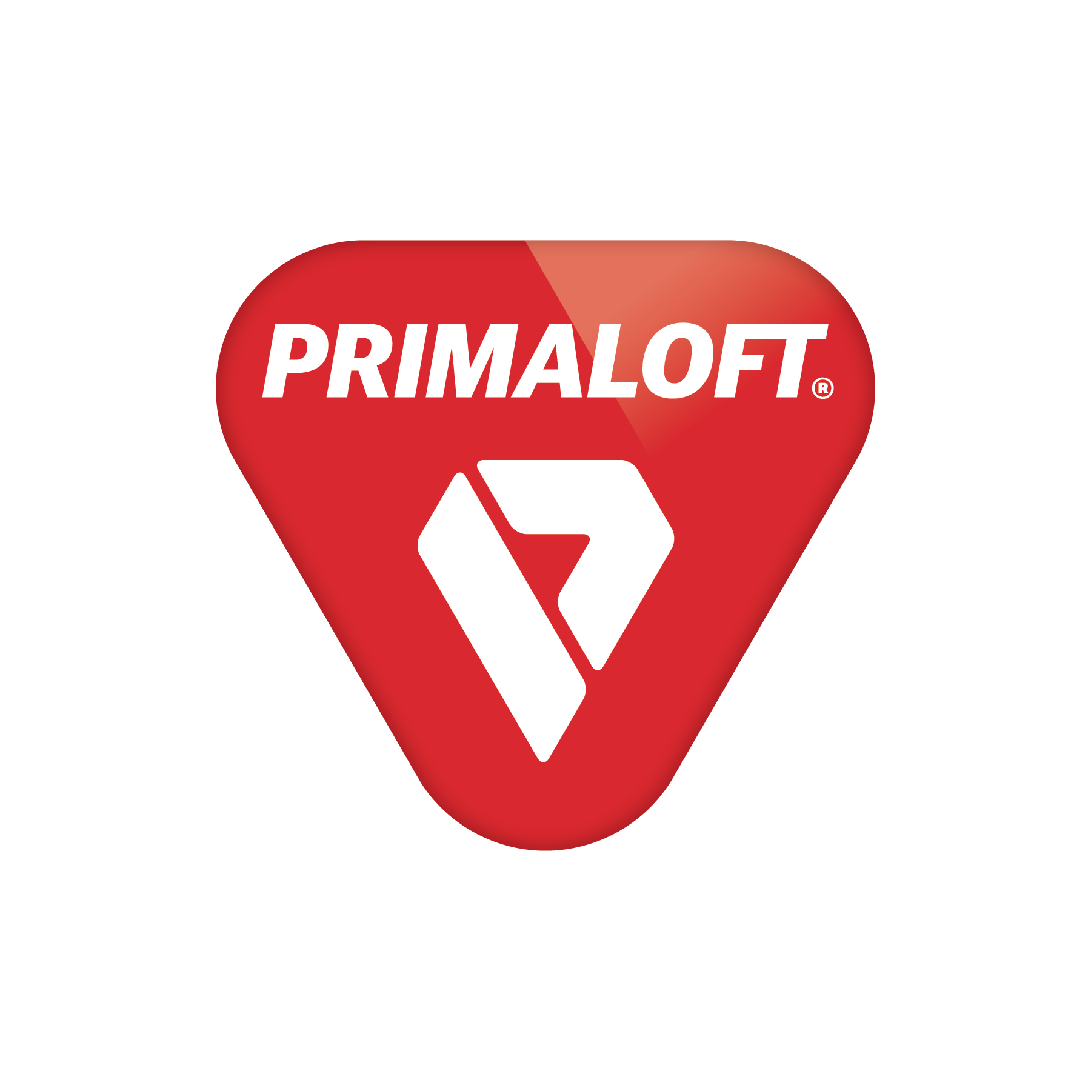
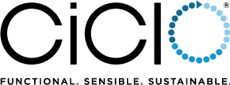
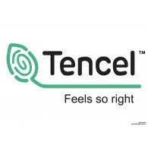
Our Technologies
Advanced Fiber Technology
Innovation for Performance & Sustainability
Biodegradable Treatment
Sustainable Fiber made from recycled plastic bottles and produced with environmentally conscious operations..
Every product made is a fusion of material innovation, world class performance and sustainability
We call this trifecta
Relentlessly Responsible™️
Biodegradable Treatment. Sustainable exile additive combined with polyester during melt extrusion I the fiber making process.
CERAVIDA FRESH
Topical treatment to prevent and remove odor molecules and microbes. Treatment is composed of natural ingredients rather than chemicals metals and synthetic binders.
Moisture Management
Touch of Nature
Performance functional polyester fiber in the construction of the fabric that speeds up the moisture absorption and helps wick moisture away from the body and lowers overall body temperature.
TENCEL™️ branded cellulosic fibers of botanic origin define a new standard of sustainability and natural comfort for you.
9

Slide 7
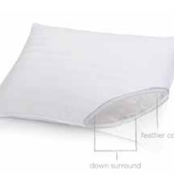
Down Halo Chamber Pillow
95/5 Feather Inner Chamber
Great Support for all Sleeping Positions
Down Outer Chamber
Medium Support
Durable Downproof
230 TC Cambric Woven Cotton
Hypoallergenic
Easy Care – Machine Wash and Dry

Slide 8
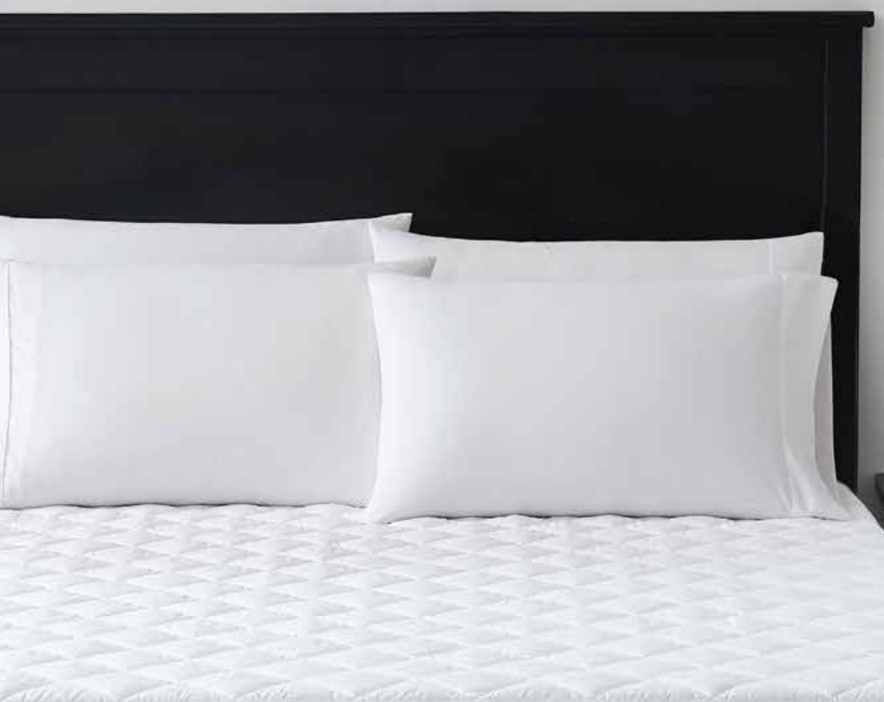
Microloft
A blown fiber that has a gel like feel. It has a slow recovery, moves with you and molds inro your shape.
GRS Certified
Gel-Like Fiber
Mimics Foam
Molds to your shape

Slide 9
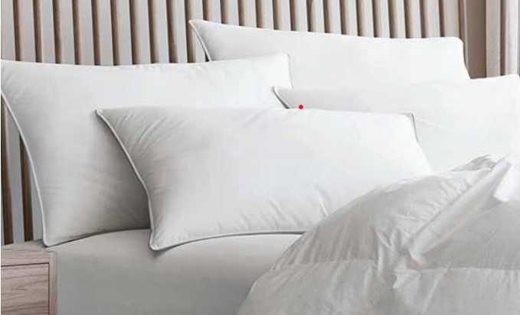
Enviroloft
Enviroloft is a blown fiber that is AAFA certified. The recycled fiber is lofty and resilient. It recovers it shape immediately and is highly durable.
Blown Fiber
Recycled Resilient
Recovers shape

Slide 10
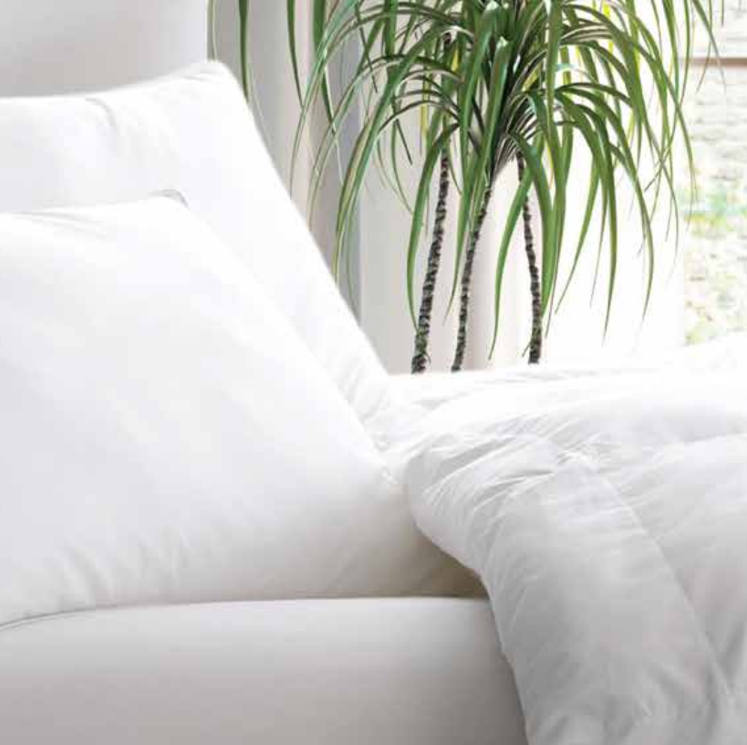
Spira
This clusterball technology is super springy and bounces back to original loft.
Spring Back Fiber
Clusterball
Highly Durable
Recovers to shape naturally

Slide 11
Super Clean TM
This fiber is perfect for hospitality as it can be washed and washed again and again. The fiber gets better with every wash adding loft to the pillow over time. It dries fast and is durable.
Loves to be Cleaned
Fiber blooms with every wash
Fast Drying
Long Lasting Loft
Durability

Slide 12
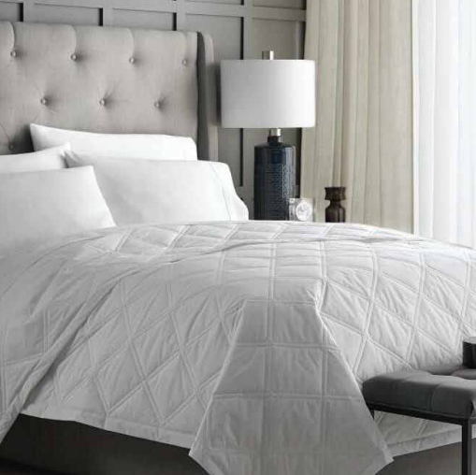
Smart Down Double Diamond Blanket
Premium White Smart Poly/Down Blend
Exclusive Double Diamond Pattern
Hypoallergenic
NoShift Sewn-Thru Double Diamond Construction
Easy Care-Machine Wash and Dry

Slide 13
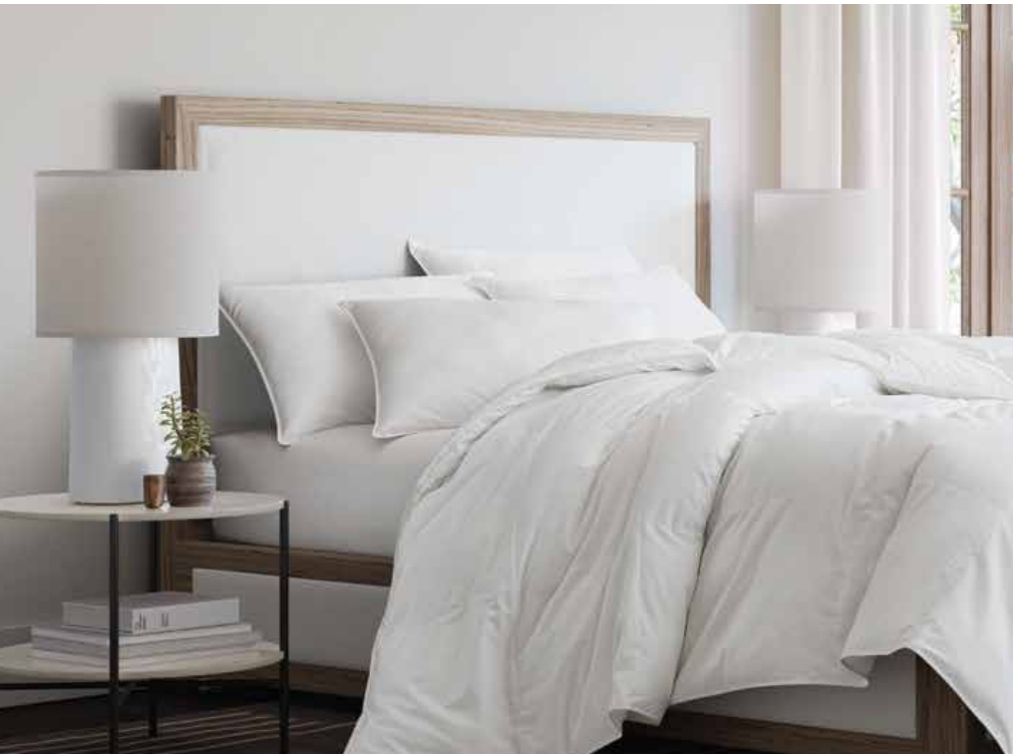
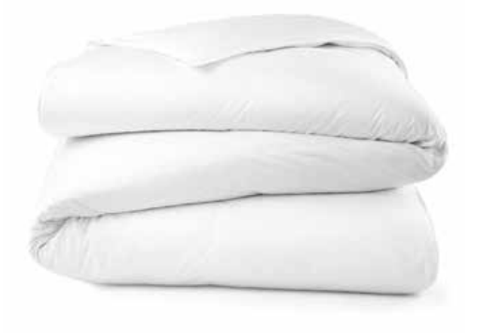
Better Comforters-Down and Synthetic Options
Continuous Comfort™
Blown Fiberfill
Durable Downproof 230 TC Cambric Woven Cotton
Hypoallergenic
NoShift™ 14" Sewn-Thru Quilted Box Construction Corner
Duvet Loops
Easy Care – Machine Wash and Dry
600 Fill Power Premium White Down
Durable Downproof 230 TC Cambric Woven Cotton
Hypoallergenic
NoShift™ 14" Sewn-Thru Quilted Box Construction Corner
Duvet Loops
Easy Care – Machine Wash and Dry

Slide 14
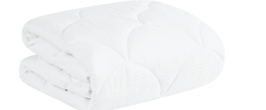
Ultra Plush 20OZ Cloud Topper-Better
Durable 230 Thread Count
100% Cotton 20 oz per square yard of fill weight
Anti-Microbial Hypoallergenic
Cloud Top Quilt Pattern Plush
All Way Stretch Spandex Skirt Snug Fit For Mattresses Up To 16” Easy Care – Machine Wash and Dry

Slide 15
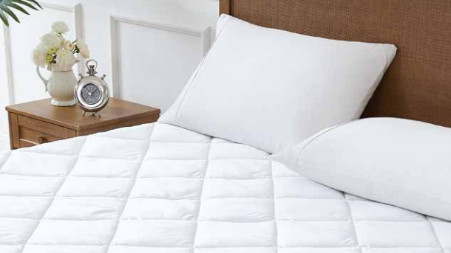
All-In-One Anti-Microbial 8OZ Mattress Pad-Better
Durable 300 Thread Count 100% Cotton
8 oz per square yard of fill weight
Waterproof
Antimicrobial
Stain-Resistant
Hypoallergenic
12” Diamond Quilt Pattern
Snug Fit For Mattresses Up To 16”
Easy Care – Machine Wash and Dry

Slide 16
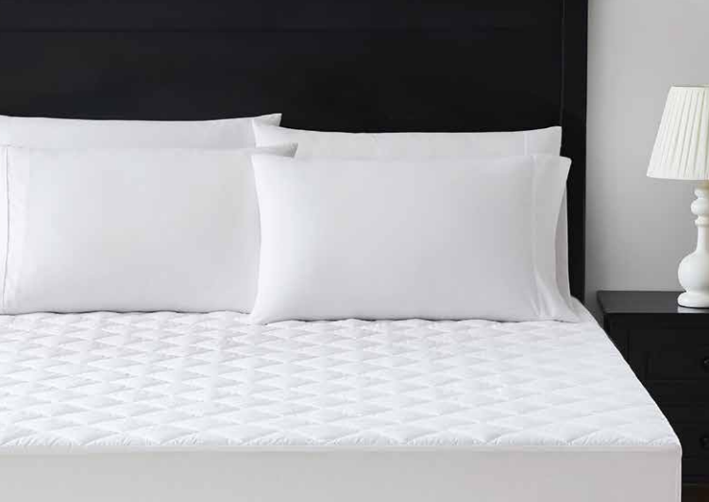
4 OZ Mattress Pad-Good
Support and Protection
Durable 200 Thread Count Microfiber
4 oz per square yard of fill weight Hypoallergenic
12” Diamond Quilt Pattern
Snug Fit For Mattresses Up To 16” Easy Care – Machine Wash and Dry

