Slide 1
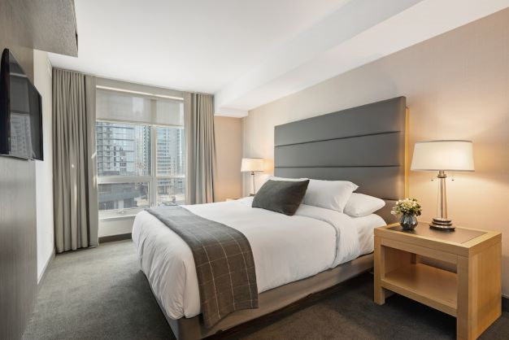


Slide 2
CORPORATE PROFILE
HISTORY…For more than 80 years, Hollywood Bed has been synonymous with bedding support products of exceptional quality and outstanding value. The company, under 3rd generation family management, has grown to become one of the most respected companies in the hospitality, contract and home furnishing industries. The company attributes much of its success to the senior management team, who has more than 125 years combined time at the company.
PRODUCTS…As a full-service manufacturer and distributor of quality bedding support products, including bed bases, bed frames, portable beds and accessories, the company can address the specific requirements of any customer, large or small. Currently, Hollywood Bed possesses 10 United States Patents, 1 Chinese Patent and has additional USA and International Patents Pending. These unique designs provide our customers with the ultimate in strength and ease of assembly in the bedding support products category.
CUSTOMER SERVICE…In addition to quality products, Hollywood Bed offers its customers the finest in customer service. The company maintains a healthy inventory of all product lines and can provide immediate shipping. Hollywood Bed recognizes that customer service is paramount to our success and embraces the philosophy that when it’s good, it’s not good enough and when it’s outstanding it needs to be improved upon.
CUSTOMERS…Hollywood Bed has established long lasting partnerships with our customers and believes fervently that working together does make a difference! Today, we are a preferred and primary supplier to many worldwide hotel brands, purchasing and management companies as well as major retailers.
SOCIAL RESPONSIBILITY…Hollywood Bed was “green” long before it was fashionable. For decades, the company has used high carbon recycled railroad T-rail for all its angle steel requirements. Not only is this the strongest raw material available in the industry, it is eco-friendly. Also, the company has a long history of giving back to the community by supporting a variety of charities. In fact, the principals of the company are the 2013 City of Hope Furniture Industry honorees.

Slide 3
Company Overview
Founded in 1925
3rd Generation Owned & Managed
Hollywood Bed Frame Provides Superior Bedding
Support Products to the:
  Hospitality Industry
  Contract Markets
  Government Agencies

Slide 4

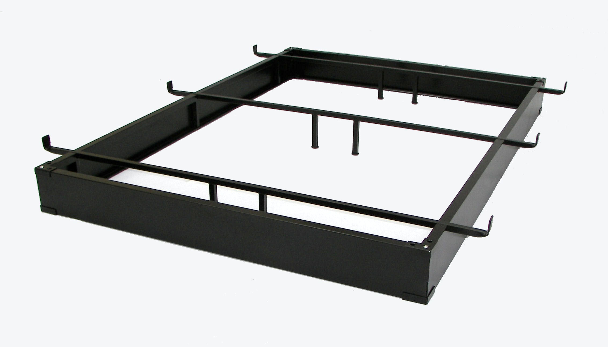
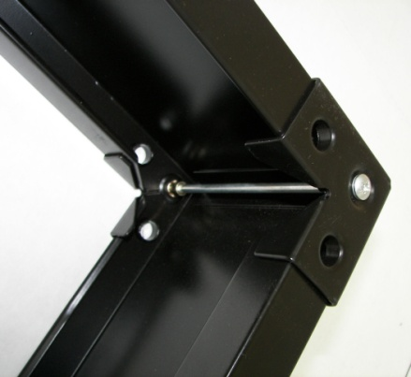
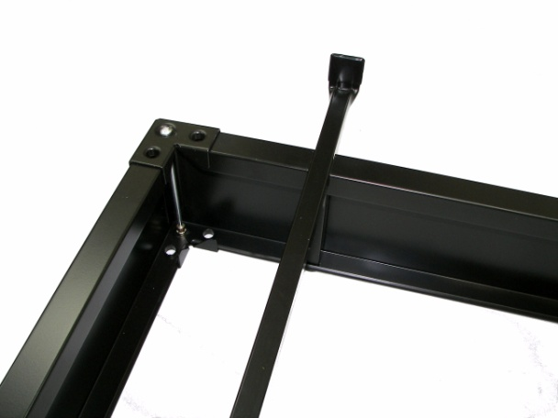
Dynamic Metal Bed Base
U.S. Patents #6,865,758 B2 and #7,155,762 B2 and #7,861,339 B2

Slide 5
Dynamic Metal Bed Base
Features and Benefits
The Ultimate Versatility – Available in 6”, 7 ½” and 10” Heights
The Ultimate for Safety-
  Recessed Design adds extra toe room for safety
  Eliminates the need to clean under the bed
  Triple Thick Wrapped Corner Panel with No Edge Wrap Exposed
The Ultimate Design –Patented–U.S. Patents #6,865,758 B2 & #7,155,762 B2; #7,861,339 B2
The Ultimate Finish - Coffee Powder Coat Finish
The Ultimate Support -
  3 Square Tube Cross Bars for increased surface area to support foundation
  Top AND Bottom Securing Corner Brackets to Ensure Stability

Slide 6

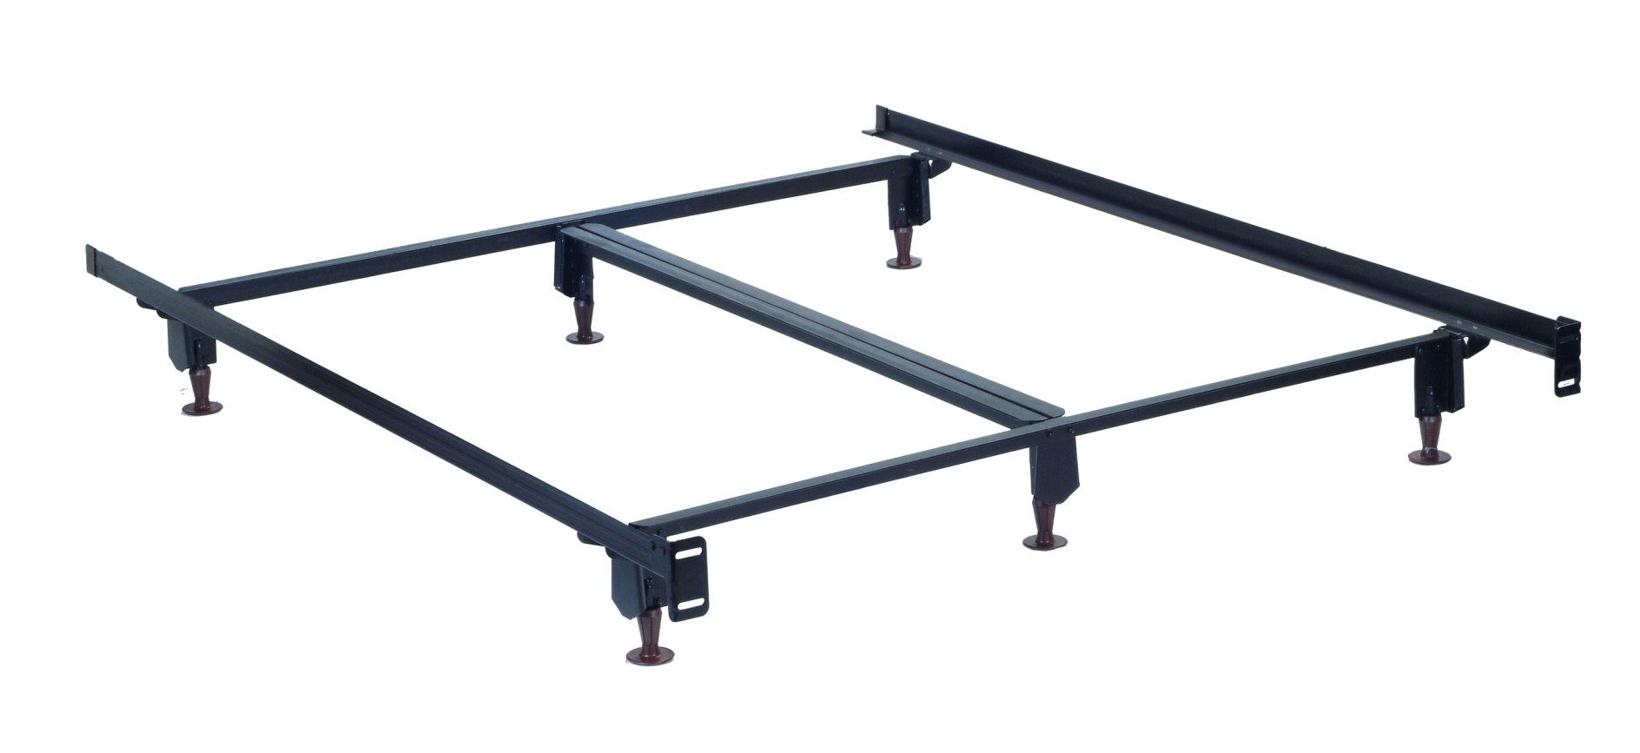
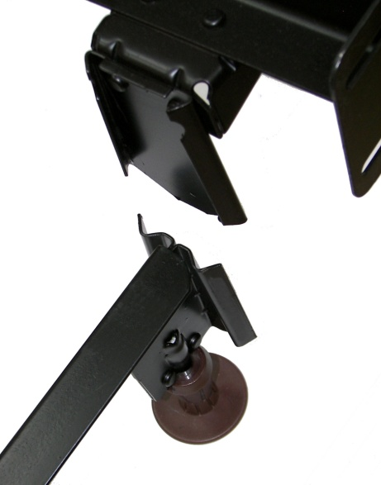
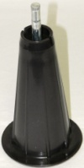
Inst-A-Matic® Bed Frame
10” High Profile Glide

Slide 7


Inst-A-Matic® Bed Frame - Features and Benefits
The Ultimate Side Rail Box Spring Support
  Extra Long 76” Long Side Rail (Extra Length to Eliminate ‘Tipping’) – Queen/King
    The Ultimate Leg Support
      6 Legs on Queen and King
      5 Legs on Full
The Ultimate Height Versatility
  7 .25” with Glides or Rug Rollers (Two Part and Steel Horn)
  10” with Glides
The Ultimate Ease of Assembly
  Wedge Lock Leg Design
  No Nuts, No Bolts, No Tools Needed for Assembly
The Ultimate for safety
  Deeply Recessed Legs and Rounded Corners to Prevent Toe Stubbing

Slide 8
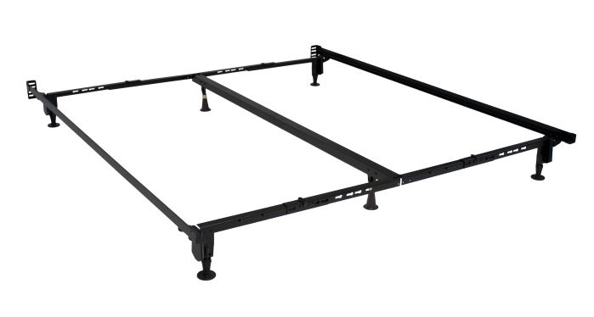
Hollywood ADA Frame - Features and Benefits
The Ultimate Side Rail Box Spring Support
  Extra Long 78.5” Long Side Rail (Extra Length to Eliminate ‘Tipping’) – Queen/King
  Adjustable widths for Queen, Cal-King, and Eastern King
The Ultimate HEIGHT FOR ADA CLEARANCE
  7 .25” with Glides (Two Part and Steel Horn)
The Ultimate Ease of Assembly
  Wedge Lock Leg Design
  No Nuts, No Bolts, No Tools Needed for Assembly
The Ultimate for safety
  Deeply Recessed Legs and Rounded Corners to Prevent Toe Stubbing
The ULTIMATE ADA FRAME FOR California’s New ADA requirement
Model# ADA-6556BG

Slide 9
Things to Remember
Dynamic Metal Bed Bases
  LIFETIME WARRANTY
  Square Tube Cross Bars for Added Strength
  Top AND Bottom Corner Brackets to Keep Bed Base Square and Stable
  Easiest and Quickest to Assemble with 50% fewer pieces
Inst-A-Matic® Bed Frames
  LIFETIME WARRANTY
  Extra Long 76” Side Rails to Prevent Tipping
  Steel Stem Glides or Rug Rollers
  Available in 7 1/4” or 10” (High Profile) Heights

Slide 10

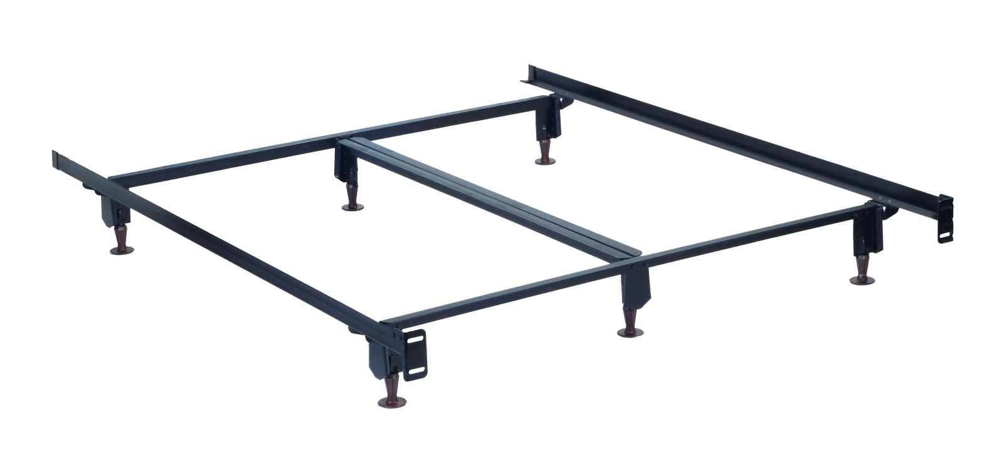

What makes our Frames so Eco-Friendly?
The GREENEST and STRONGEST Bed Frames on Earth!

Slide 11


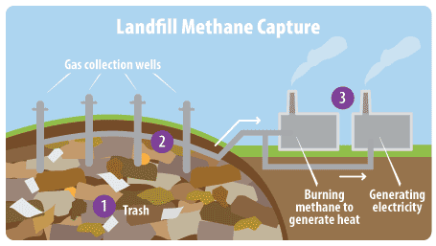

What Makes the Hollywood Bed Frames so Eco-Friendly?
Made from High Carbon Recycled Railroad T-Rails.
Our steel mill has developed a process by which methane gas is “Captured” from nearby Landfills to power the ovens that melt down the rails, which are then formed into angles.
The Use of the “Captured” Methane Gas not only saves precious natural resources, it does not emit greenhouse gases into the environment.
The Result… a Negative Carbon Footprint.

Slide 12

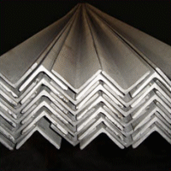

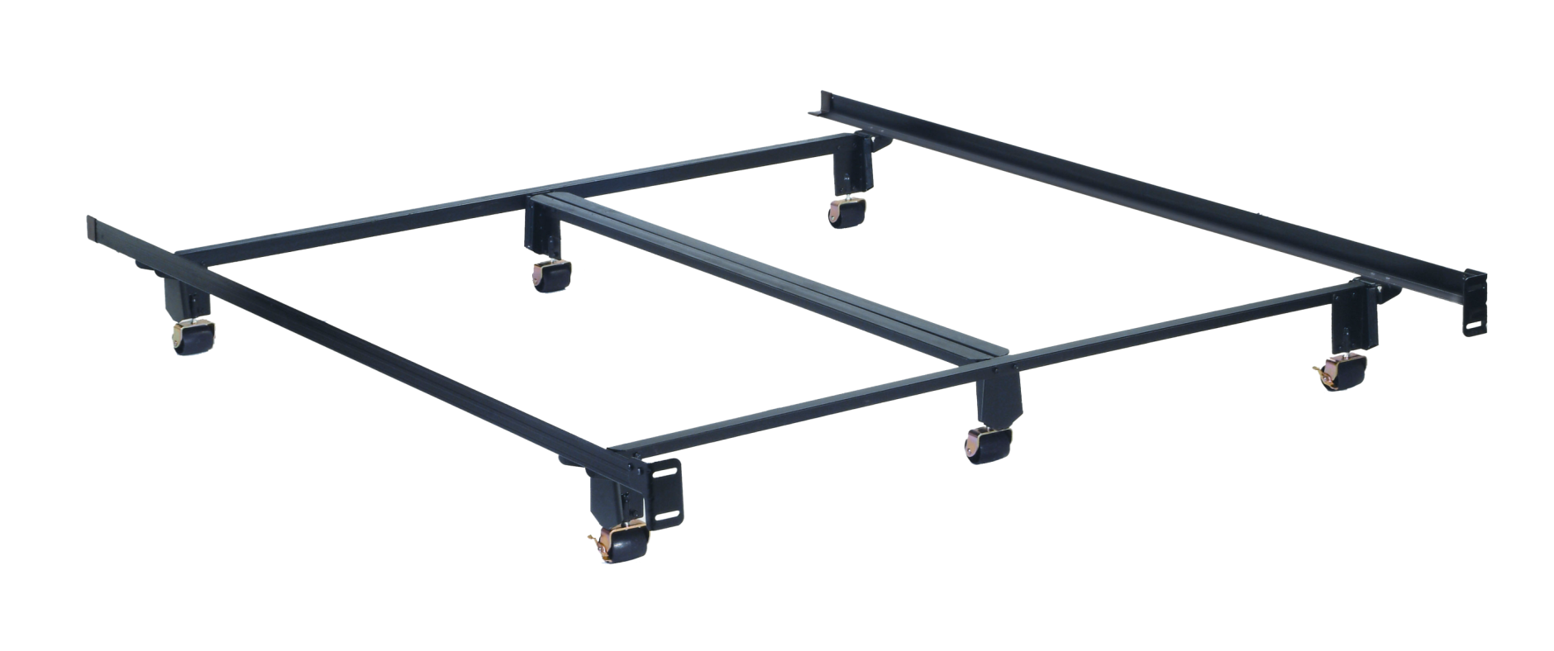



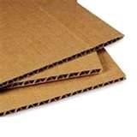
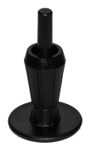

Inst-A-Matic® Bed Frames
Greenest Steel - Recycled Railroad T-Rail
Water-Based Paint
Recycled Corrugated Packaging
Recyclable Glides
& Rollers

Slide 13
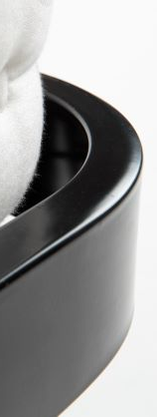
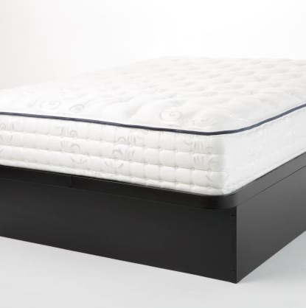
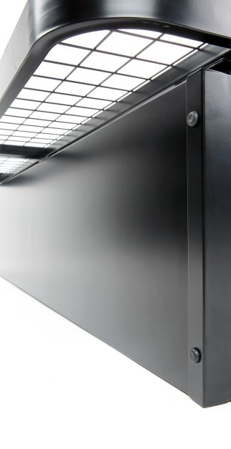
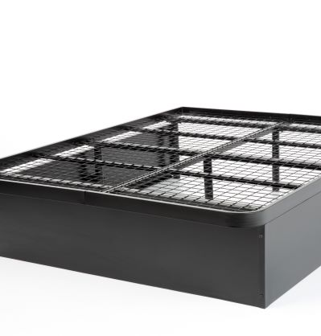
GOLIATH STEEL PLATFORM
Superior Steel Construction: Underbed Support
Heavy Duty Cross Support, Tubular Construction
Raised Perimeter Edge, for Mattress Retention
Welded Heavy Gauge Wire Grid for Mattress Support
Quick and Easy Assembly
Ebony Powder Coated Finish

Slide 14
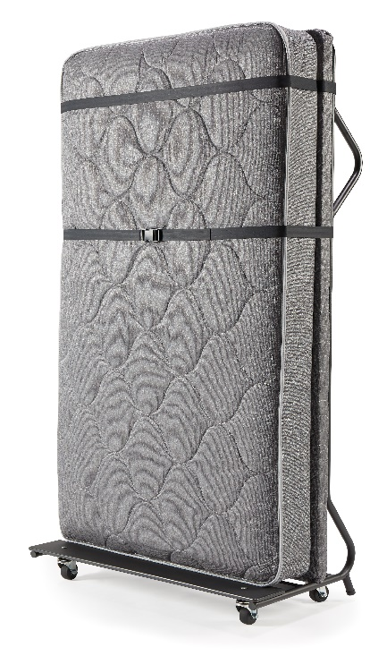
THE HOLLYWOOD EZ SLEEPER ®
A Profitable Option to the Conventional Rollaway Bed
Thick Innerspring Mattress (8”) & Foundation for Added Comfort
Lightweight Design to Save Housekeeping Time & Effort
Easy to Move Through Hallways with Four (3”) Heavy Duty Swivel Casters
Durable Padded Headboard
Adjustable Straps to Securely Hold Mattress & Pillowcase in Place
Mattress Meets California’s Stringent Film Retardant Requirements

Slide 15
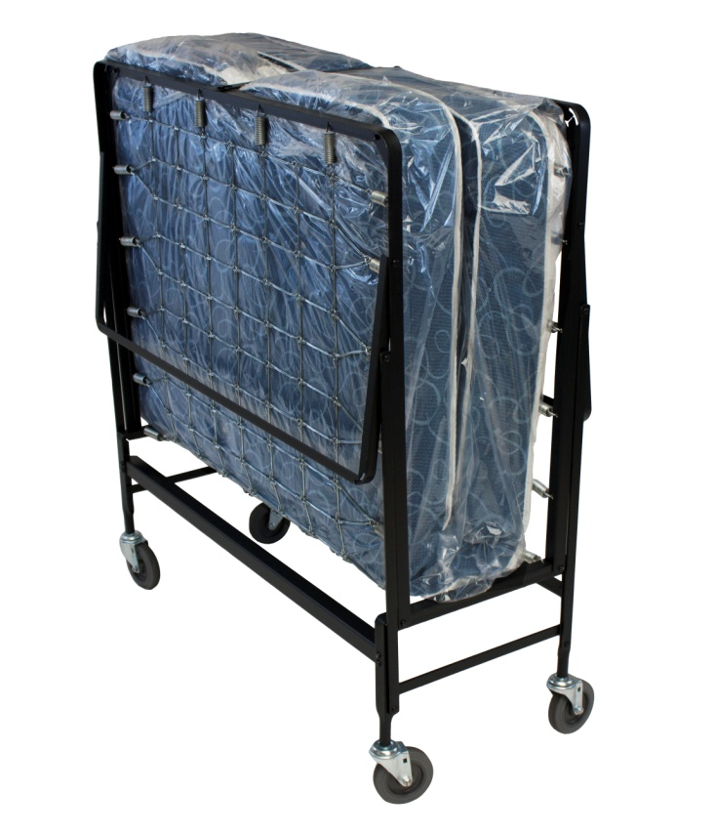
HOLLYWOOD ROLLAWAY BEDS (955 Series)
Features & Benefits:
Designed for Comfort and Durability
Heavy Duty High Carbon Angle Steel
Automatic Leg Opening
Rounded Corners – Firmly Braced and Engineered for Trouble Free Use
Double Strand Wire Link for Proper Mattress Support
5” Ball Bearing Wheels
Poly Fiber or Innerspring 39” Mattress

Slide 16
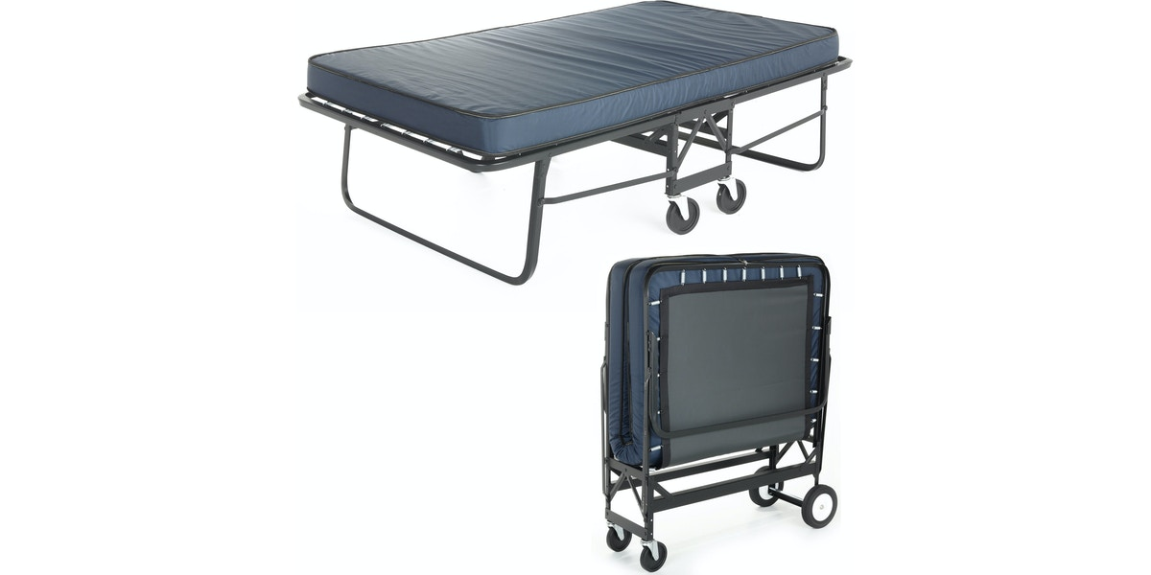
HOLLYWOOD ROLLAWAY BEDS (1291P
Series)
Features & Benefits:
Designed for Comfort and Durability
Heavy Duty High Carbon Angle Steel
Automatic Leg Opening
Rounded Corners – Firmly Braced and Engineered for Trouble Free Use
Poly deck for Proper Mattress Support
2-4” and 2-8” wheels for easy mobility
Poly Fiber or Innerspring 39” Mattress
Angle Iron Construction

Slide 17
Contact Information
  FreemanKelley, Inc.
  1700 Stardust Lane
  Olean, NY 14760
  800-935-4702
  FreemanKelley.com
  info@freemankelley.com

Slide 18

Warranty Information

